Slide 1
Santorini Project
Developed by Cristian Cojocaru, Luca Colasanti, Stefano D’Angelo

Slide 2

Useful Resources

Slide 3


Notion
Calendar sharing
External resources links
Trello: Kanban-style list-making application
Workflow organization
Task identification

Slide 4
Model

Slide 5
Map Abstraction
GameMap is a matrix of Cell
Interface that provides all necessary methods to move among Cells
Cellable
Cell
GameObject
Abstract class that represents all possible objects populating the GameMap
Worker
Block

Slide 6
Cell Abstraction
Every Cell is seen as a Stack of GameObjects
Cell becomes occupied
Cell becomes blocked
Worker
Dome
Level 3 Block
Level 2 Block
Cell level
is modified
Restricted to Atlas
Level 1 Block
Cell

Slide 7
Turn Abstraction
A turn is a sequence of Game Operations:
Game Operation
Your Turn = [ ];

Slide 8
Mandatory and optional Game Operations
Mandatory
Optional
OP
( OP )
can cause loss
can be skipped

Slide 9
Inside a Game Operation
Computes lambdas and Notifies delegate
Game State
Game Delegate
Result
Lambdas

Slide 10
Game Operation Phases
Generic Game Operation
Computes lambdas and Notifies delegate
Worker Selection
Build Game Operation
Move Game Operation
Computes lambdas and Notifies delegate
Loss Check
Computes lambdas and Notifies delegate
Position Selection
Win Check
Custom
Block Selection
Movement
Building

Slide 11
But how do Phases work?
Game Operation Phases
Computes lambdas and Notifies delegate
Game Rule
Expandable
Rest
Exp
Exp
Rest
Exp
Rest
Exp
Rest
Exp

Slide 12
Expandable Predicate
Expandable Predicate
.test(gameState) =
false
OR
Exp
.test(gameState)
OR
Exp
.test(gameState)
OR
Exp
.test(gameState)
first expansive then restrictive
AND
Rest
.test(gameState)
AND
Rest
.test(gameState) ;
Used by:
Position Selection
Win Check

Slide 13
Expandable List Function
Expandable List Function
.apply(gameState) =
[ ]
∪
Exp
.apply(gameState)
∪
Exp
.apply(gameState)
∪
Exp
.apply(gameState)
first expansive then restrictive
∖
Rest
.apply(gameState)
∖
Rest
.apply(gameState) ;
Used by:
Block Selection

Slide 14
Expandable Consumer
Expandable Consumer
.accept(gameState) =>
Exp
.accept(gameState) ;
Exp
.accept(gameState) ;
Exp
.accept(gameState) ;
FIFO
Exp
.accept(gameState) ;
Exp
.accept(gameState) ;
Used by:
Movement
Building

Slide 15
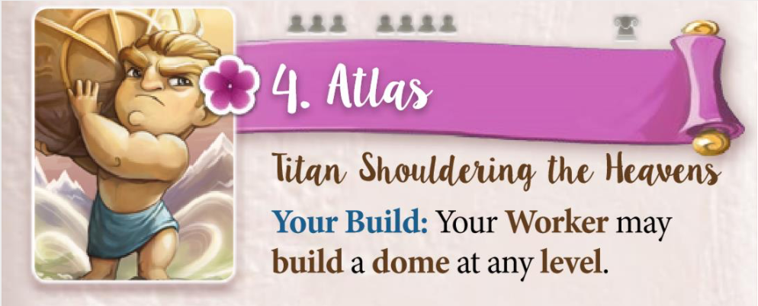
Static Expansions
M
B
=
Exp
(gameState) -> [ BlockType.DOME ] ;
allowedBlockTypes().addExpansion(new ListFunctionExpansion<>(state -> Collections.singletonList(BlockType.DOME), true, GameMarker.defaultMarker()));

Slide 16
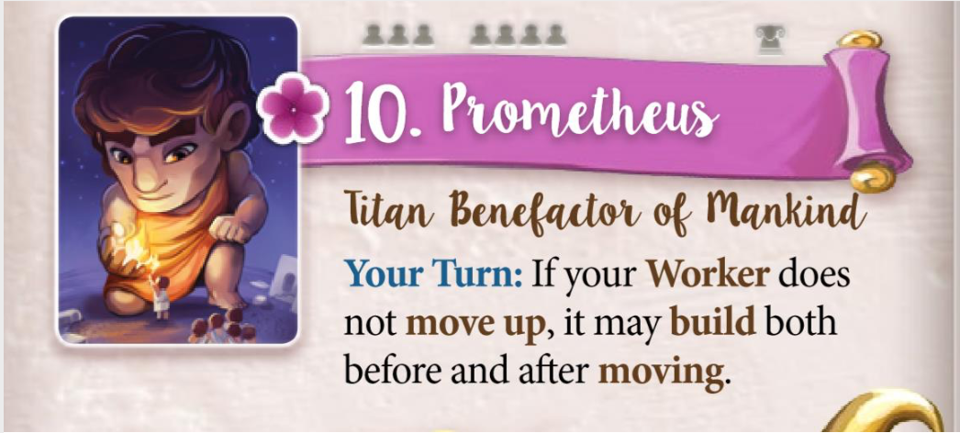
Dynamic Expansions
( B )
M
B
=
Rest
(s) -> add new expansion( (t) -> !t.isGoingUp() )
building().addExpansion(new ConsumerExpansion<>(s ->
s.result().expansionRules().mRules().allowedPositions().addExpansion(new PredicateExpansion<>(t ->
t.map().getLevelDifference(t.chosenPosition(), t.activeWorkerPosition()) <= 0 , false, s.currentPlayerAsTarget()))
, GameMarker.defaultMarker()));

Slide 17



Game Markers
Exp
Add last result expansions
Marker
Marker
Marker
Filter expansions by current player
Marker
owner
target
Remove used or invalid expansions

Slide 18
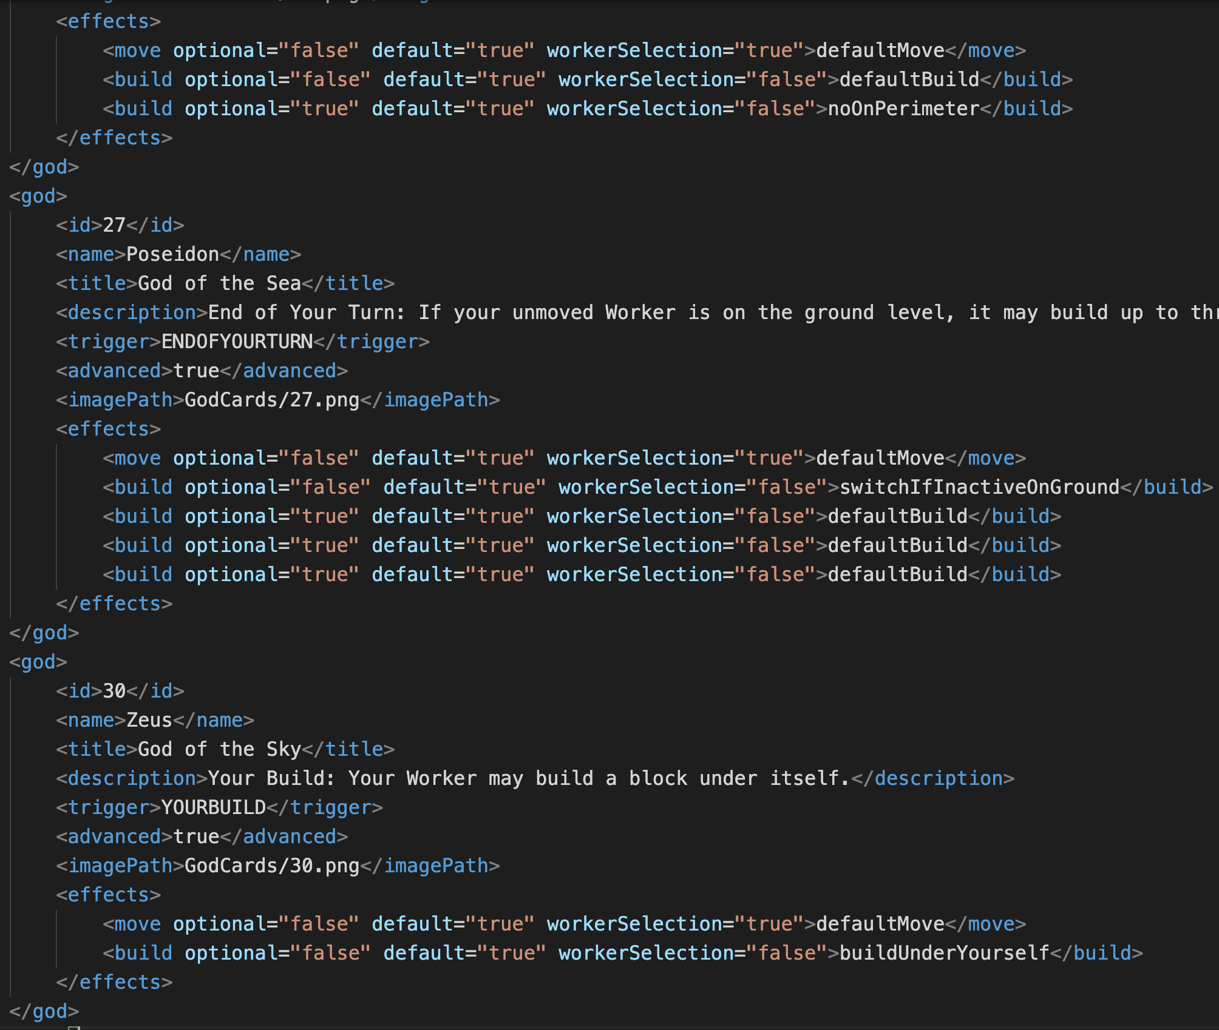
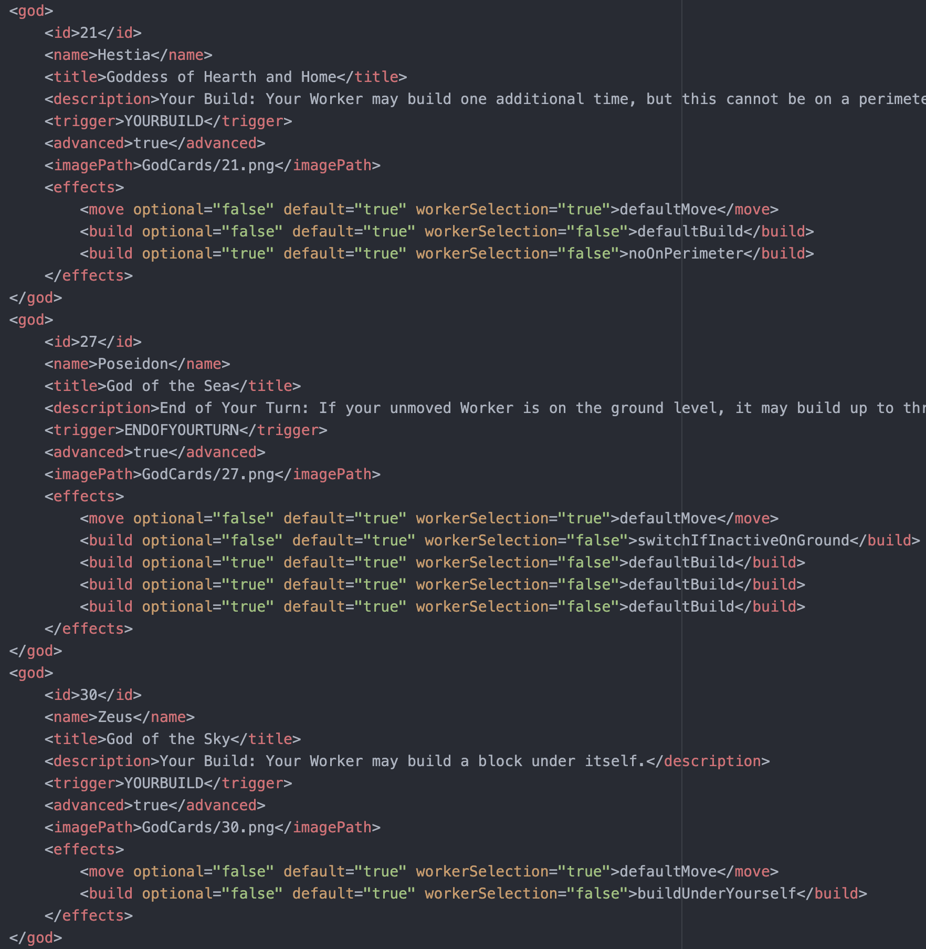
Our final cards abstraction

Slide 19
Controller

Slide 20
Model requests
Controller
VirtualView
Receives model request and prepare a new message
Sends the message via server and waits for answer(s)

Slide 21
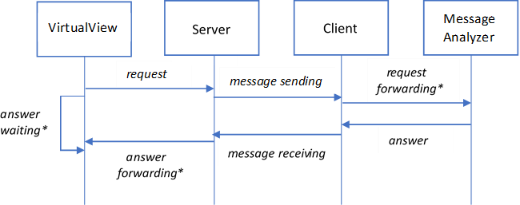
Communication handling
SerializableMessage
on separate threads

Slide 22
Types of messages
Implements Serializable
SerializableMessage
TextMessage
WinMessage
GameMessage
QuitMessage
LobbyMessage
KickMessage
InterruptionMessage
Textual content
Win report
Game content (generally displayable data)
Multiple disconnection
Commands and players tables
Player kick
View interruption

Slide 23
View

Slide 24

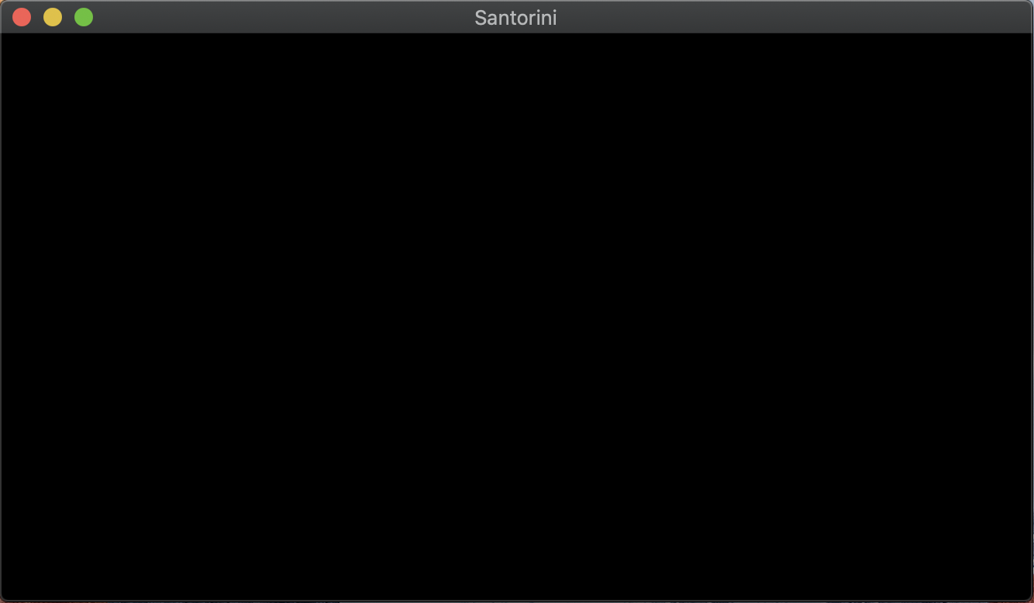
GUI Structure
GUIScene
Scene 1
runSafely
Delegate
GUISceneController
runAsync
Scene 2
Delegate
GUIView
Scene 3
Threading
Delegate
protected void runSafely(Runnable runnable) { Platform.runLater(runnable); }
Controller
protected void runAsync(Runnable runnable) { new Thread(runnable).start(); }

Slide 25
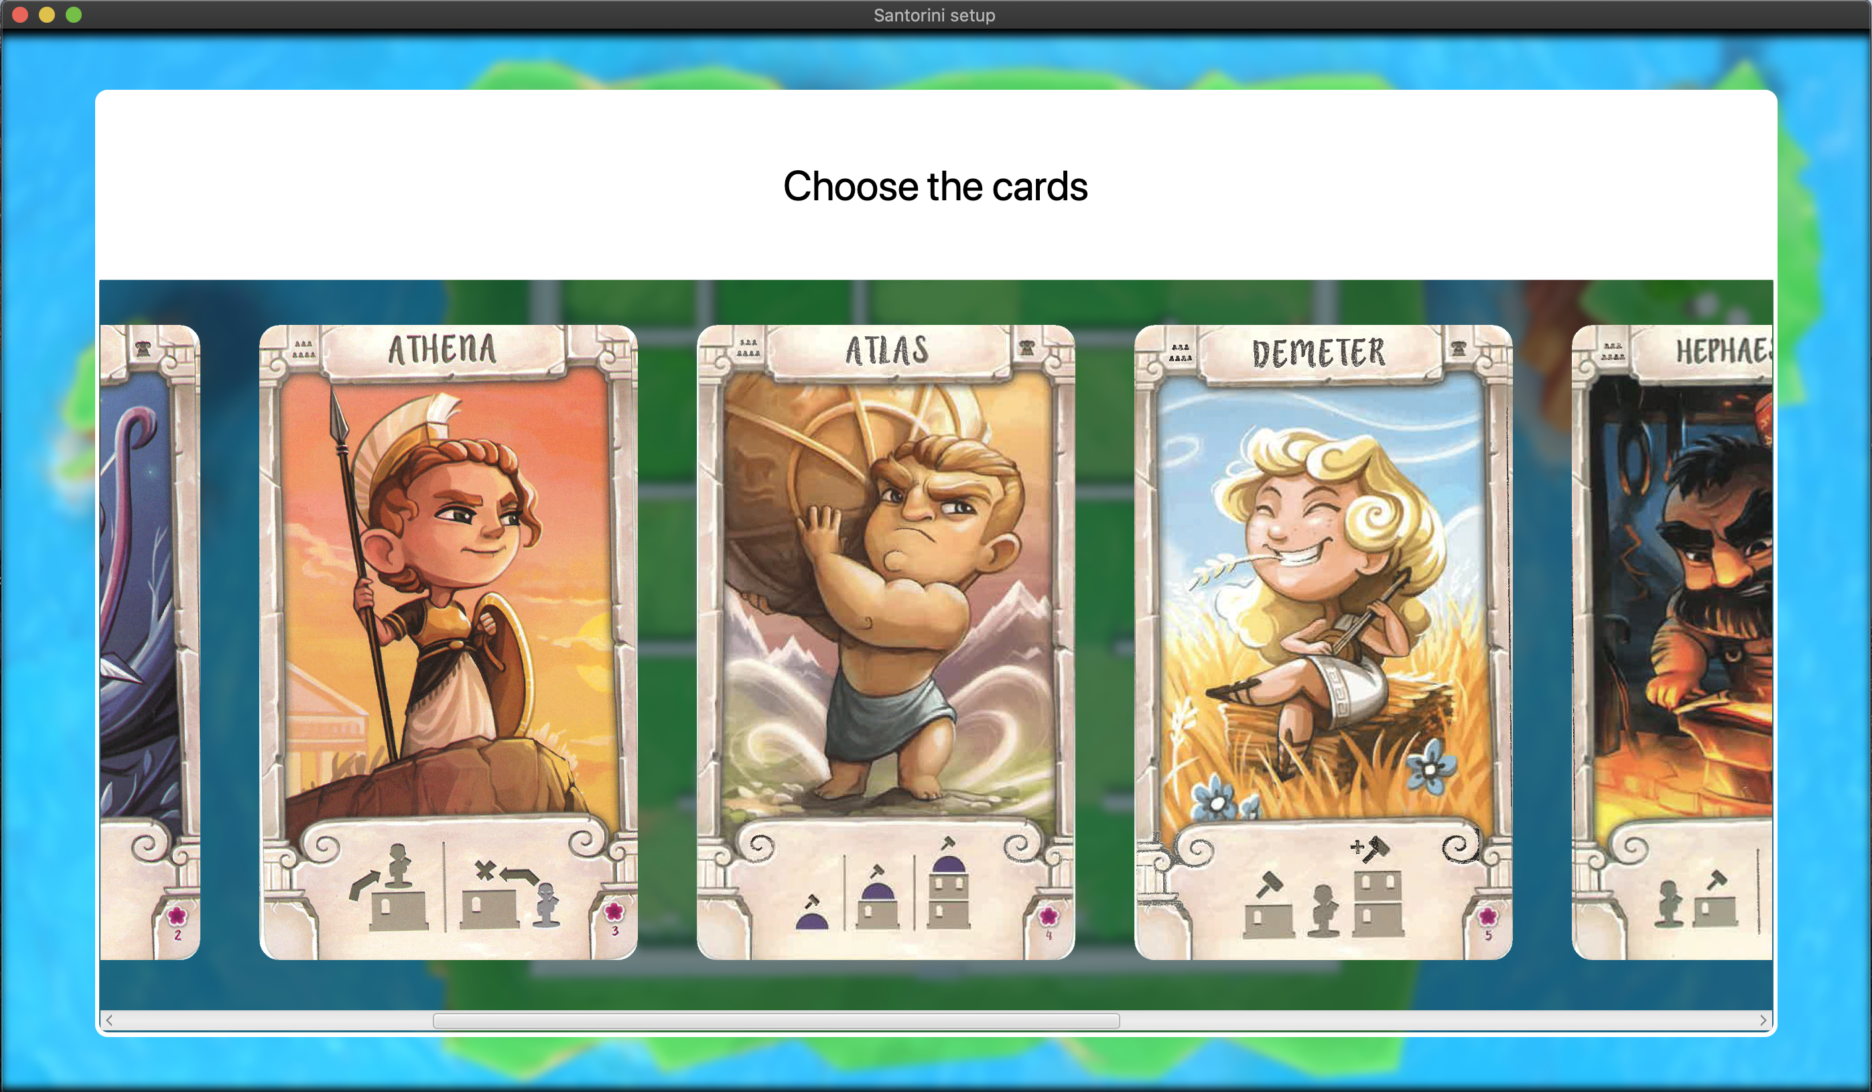
GUI is resizable!

Slide 26
Input reading on CLI
Reading thread
Local input check
Indirect sending
Message sending
Interruption
Listen for new inputs
Input discarding or forwarding
Direct sending

Slide 27
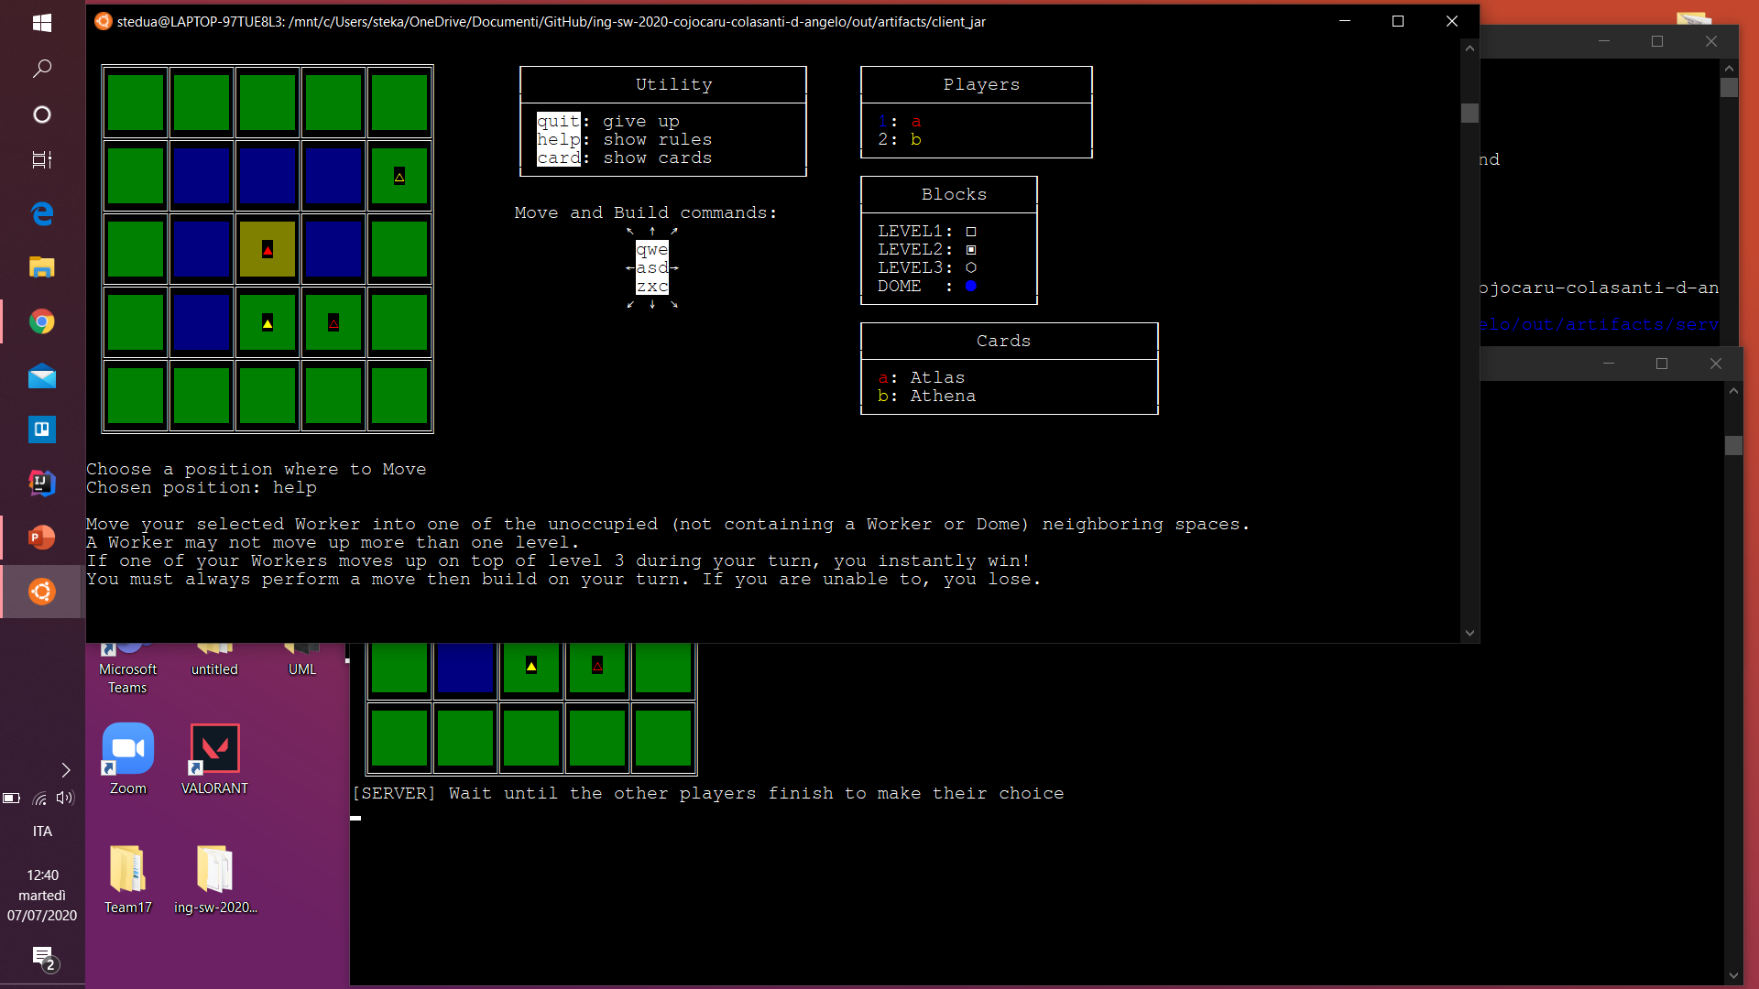
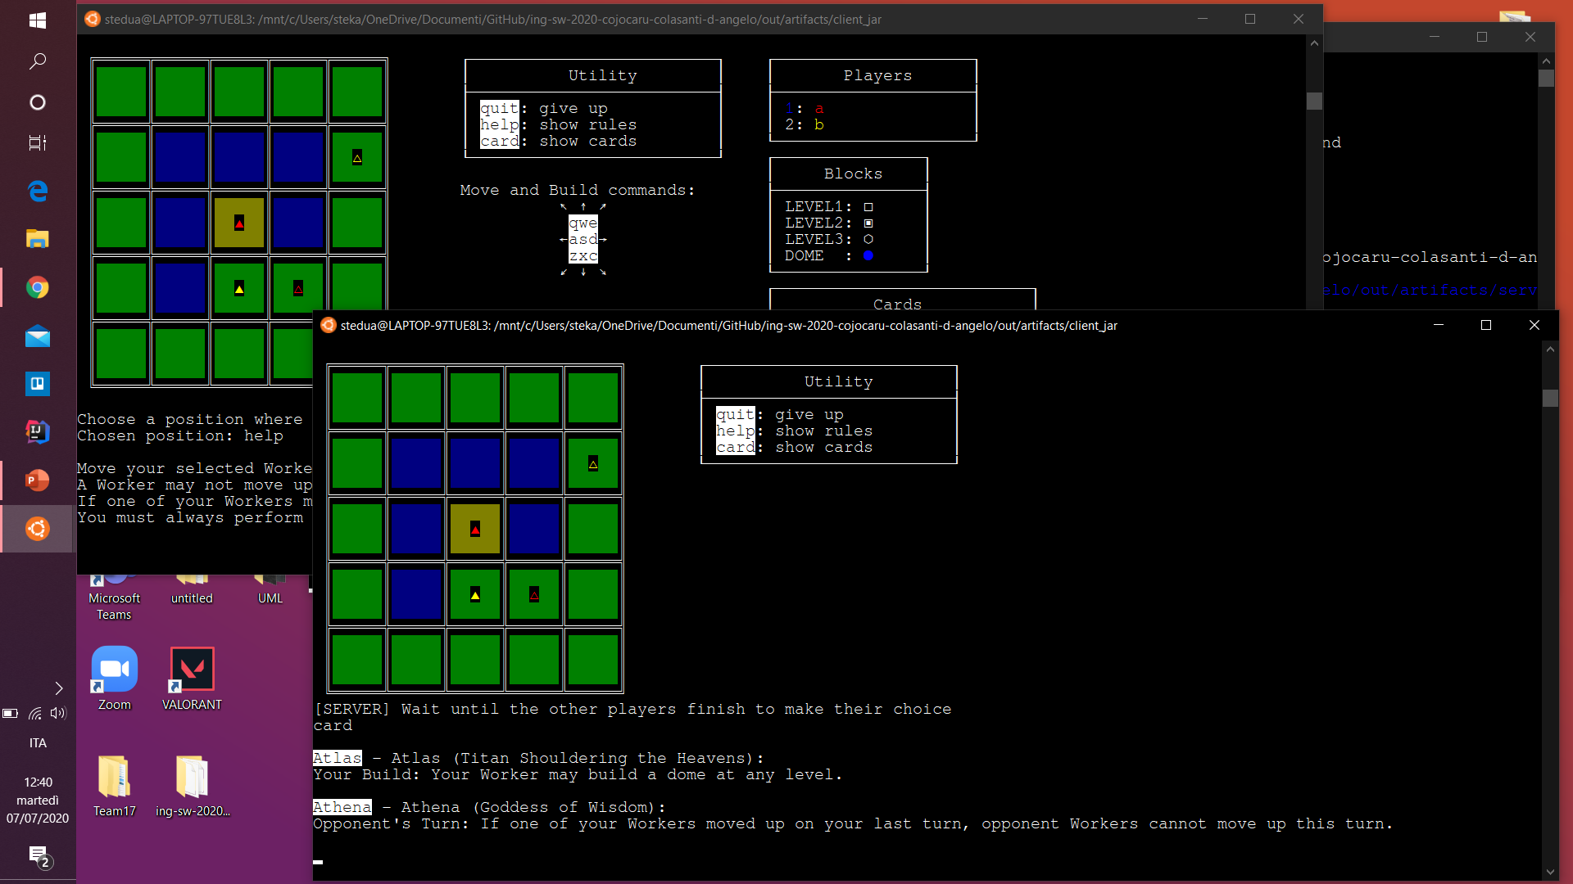
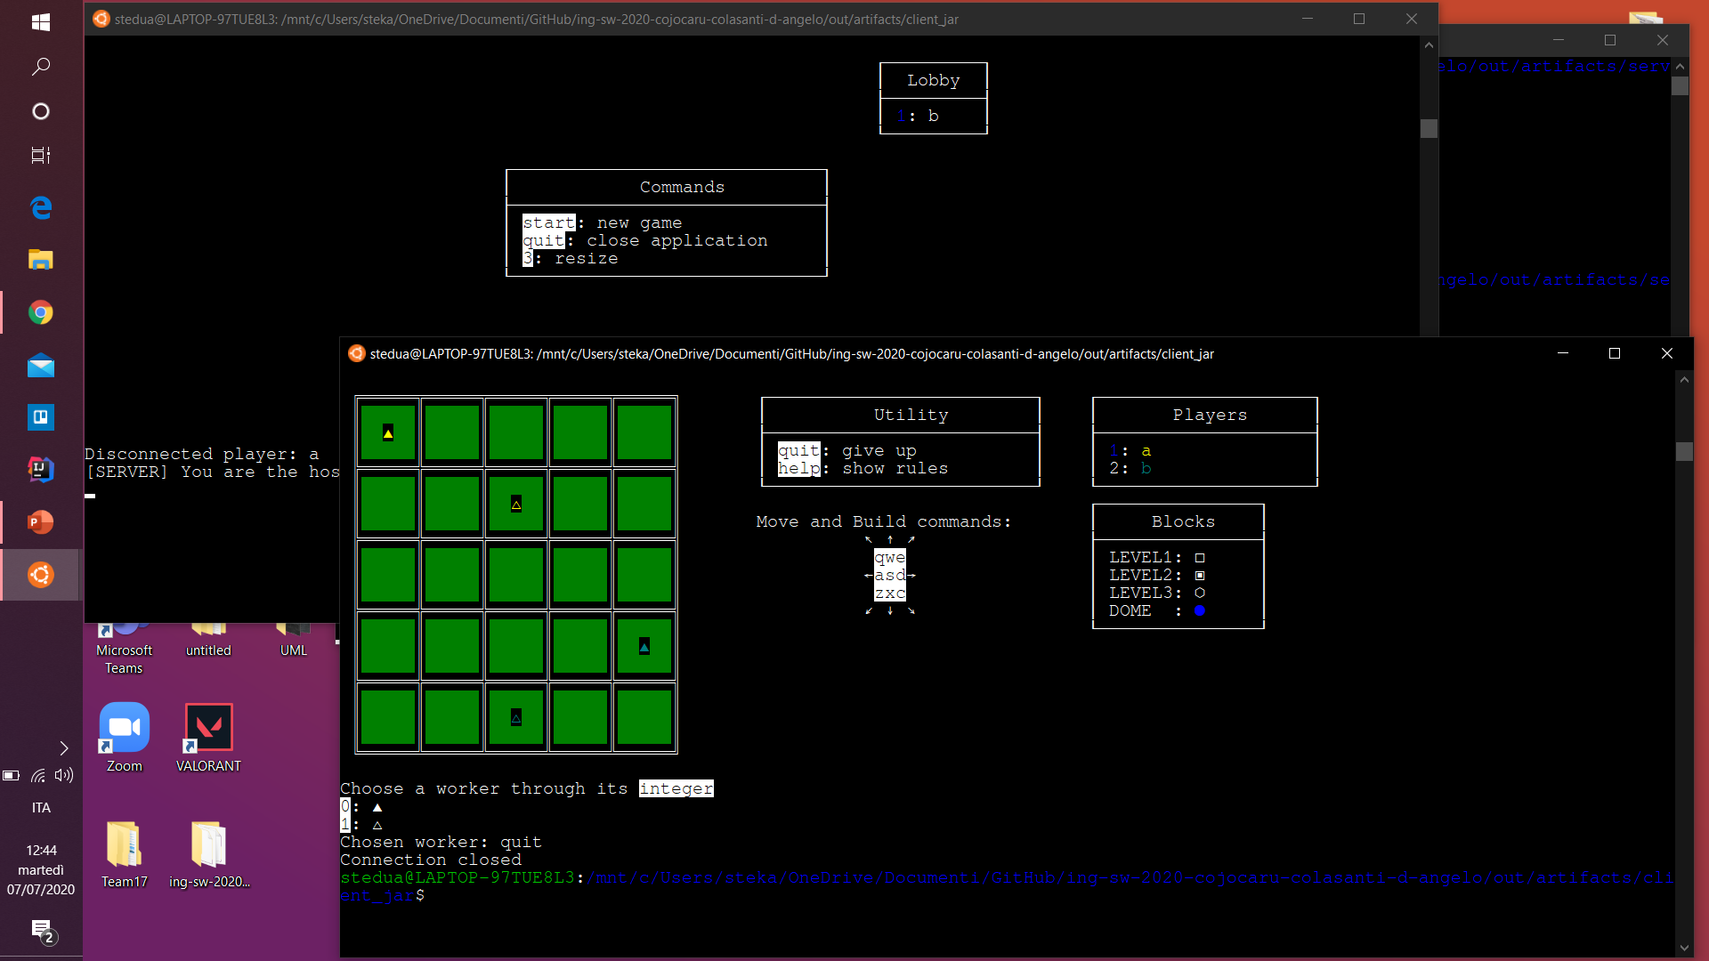
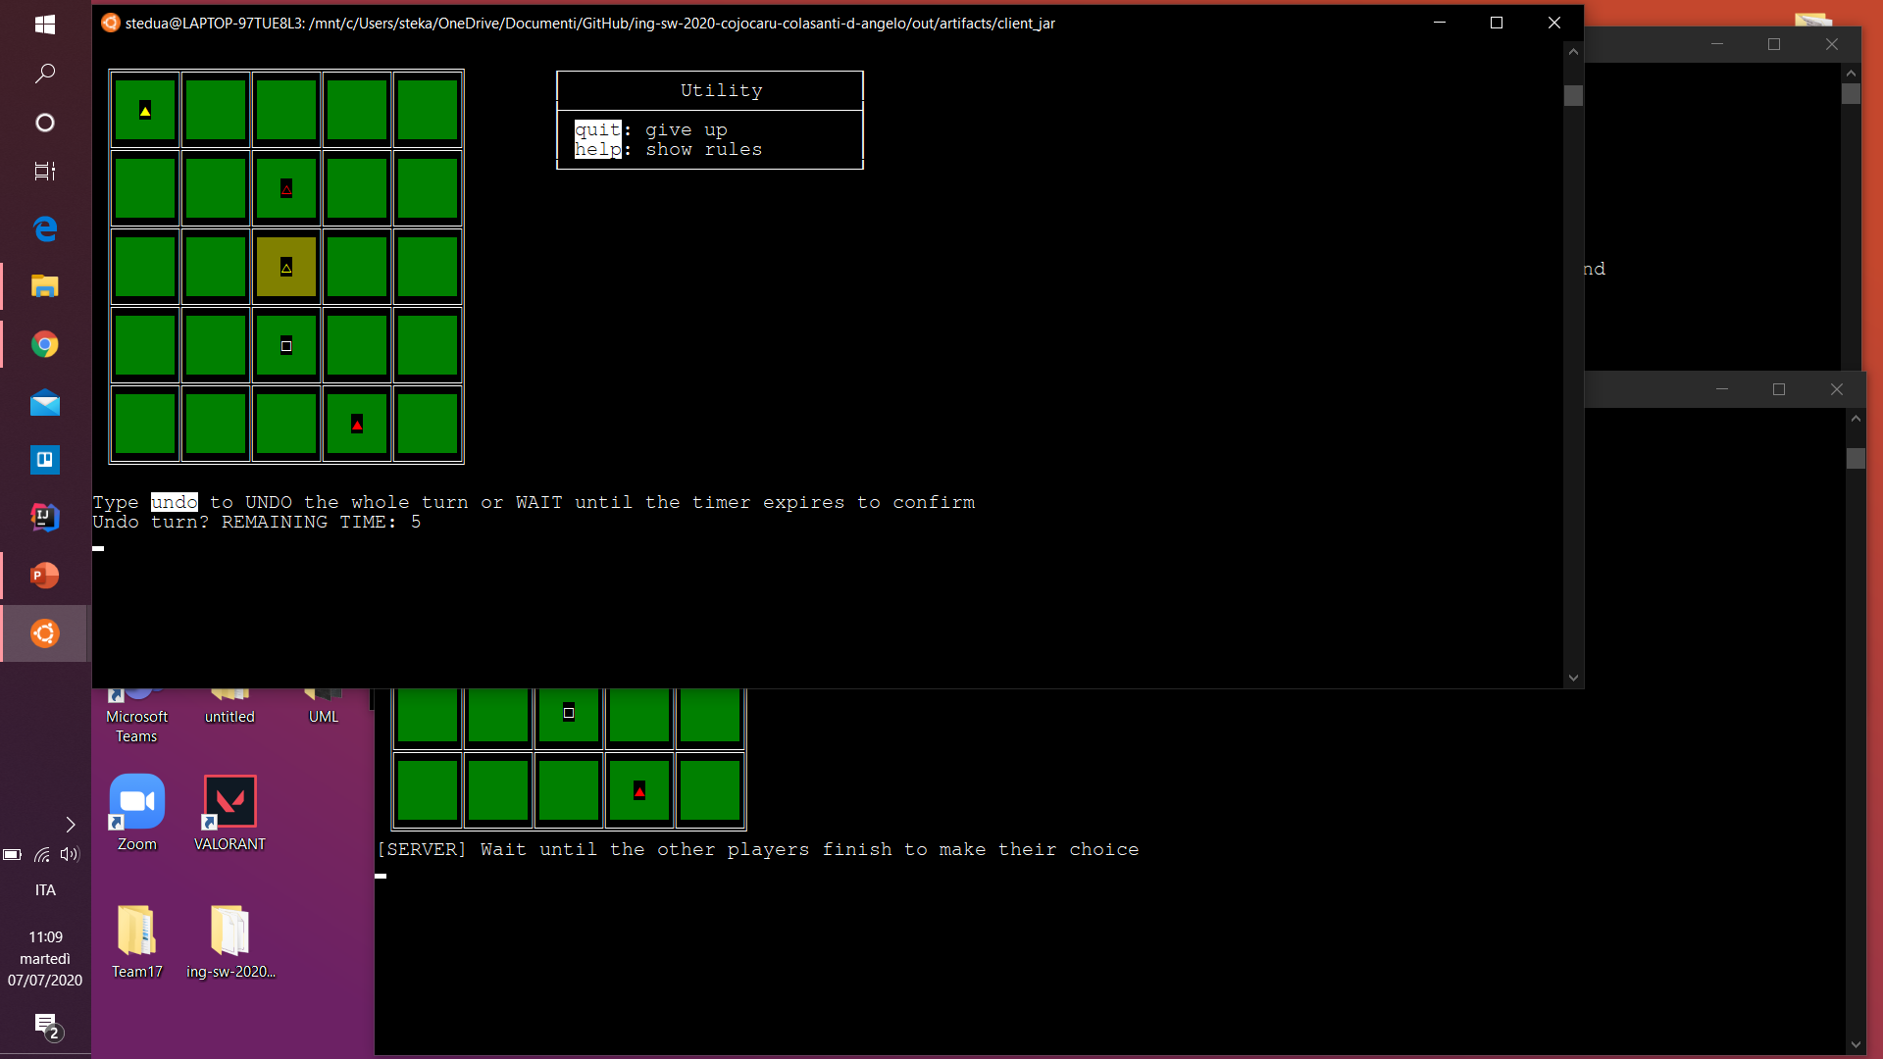
Utility inputs and Undo
help
card
quit
undo

